Slide 1
Chulalongkorn
University
Presentation
August 2022

Slide 2
Introductions
Dr Deborah Pike
Principal Consultant
Supply Chain, APAC
Brent Gorham
Supply Chain Lead
APAC

Slide 3
What type of business use connected planning

Slide 4
Why do businesses need connected planning
Integrated Business Planning (IBP) – or as we like to call it, Connected Planning driven by Supply Chain
Enabling visibility, agility, collaboration across the business to accelerate revenue growth, expand margins and better manage risk
Sales
Procurement
IBP
Connected Planning
driven by
Supply Chain
Marketing
Human Resources
Supply Chain
Finance

Slide 5
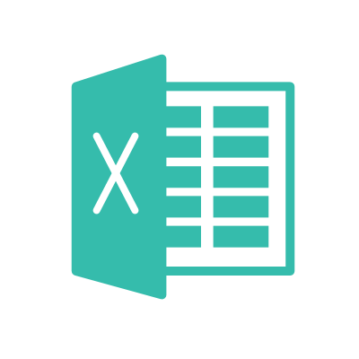
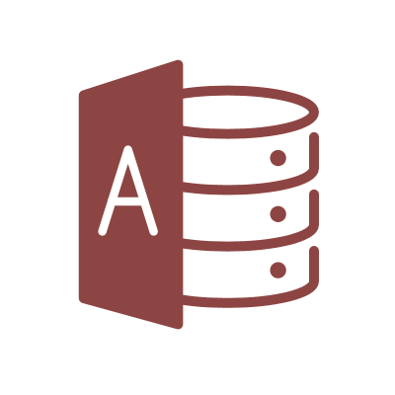
Digital Supply Chain Planning Framework
Intra Collaboration Inter
Days Planning Time Periods Months
Detailed Data Granularity Aggregate
Daily Planning Frequency (Semi)Annual
Short Planning Horizon Long
IBP
LT Dem Trends
CapEx
Decisions
Partner
Contracts
Finance
S&OP
DP
MP/PP
Mid-term
Collab
Supply Chain
S&OE
Forecast
Consump-tion
Supply Plan Adjust-ment
Tactical Collab
Customer EDW
Anaplan Data Hub
Customer EDW
Enterprise Asset Master
Enterprise
Decision
Repository
Data
Extension
Decision
Rule
Book

Slide 6
Aligning decision making
Intra Collaboration Inter
Connected Planning Supply Chain solutions reflect decision granularity:
Models share decisions with each other through DataHub
Exceptions are continually evaluated
Multi-enterprise collaboration occurs at every planning level
IBP
LT Dem Trends
CapEx
Decisions
Partner
Contracts
Finance
S&OP
DP
MP/PP
Mid-term
collab
Supply Chain
S&OE
Forecast
Consump-tion
Supply Plan Adjust-ment
Tactical Collab
Customer EDW
Anaplan Data Hub
Customer EDW
Enterprise Asset Master
Enterprise
Decision
Repository
Data
Extension
Decision
Rule
Book

Slide 7
Converging the Supply Chain - horizontally
Intra Collaboration Inter
IBP
LT Dem Trends
CapEx
Decisions
Partner
Contracts
Annual contractual decisions through multi-enterprise operating structure
Finance
S&OP
DP
MP/PP
Mid-term
Collab
Monthly S&OP, supply/demand match, multi-enterprise collaboration through consensus planning
Supply Chain
S&OE
Forecast
Consump-tion
Supply Plan Adjust-ment
Tactical Collab
Weekly S&OE, demand tracking, supply adjustments, multi-enterprise collaboration to the weekly operating plan
Customer EDW
Anaplan Data Hub
Customer EDW
Enterprise Asset Master
Enterprise
Decision
Repository
Data
Extension
Decision
Rule
Book

Slide 8
Horizontal Supply Chain Customer examples
Supply Planning
Demand Planning
20% Productivity Improvements
Improved Forecast Accuracy
Real-time visibility across data and exceptions
Supply Planning
Demand Planning
Revenue Forecasting
OpEx Planning
Enterprise Level Visibility
70% faster data integration
Financial objectives inform Supply Plans
Demand Planning
Capacity Planning
Production Planning
Inventory Planning
Sales Planning
S&OP
3x Faster Supply Planning Response
Improved Forecast Accuracy
Optimized Inventory Investments
ERP
Demand
Planning
Demand
Planning
CONNECTED PLANNING
Supply
Planning
ERP
Revenue Forecasting
ERP
CONNECTED PLANNING
CONNECTED PLANNING
S&OP
OpEx
Planning
Supply
Planning
Demand
Planning
Inventory
Planning
Supply
Planning

Slide 9
Converging the Supply Chain - vertically
Intra Collaboration Inter
Scheduled planning process
Continuous monitoring and planning
IBP
LT Dem Trends
CapEx
Decisions
Partner
Contracts
Finance
Annual contractual decisions propagated down as reference values
Exception models compute impact and propagate up based on decision rulebook
Reference
Impact
S&OP
DP
MP/PP
Mid-term
Collab
Monthly consensus plan propagated as targets to be achieved
Exception models compute impact and propagate up based on decision rule book
Target
Impact
Supply Chain
S&OE
Forecast
Consump-tion
Supply Plan Adjust-ment
Tactical Collab
Weekly/daily S&OE plan exported to exec systems
Actuals monitored with minimal data latency
Target
Actuals
Events
Dem
Events
Prod, Dist Events
Partner Events
SC Exec
Anaplan Data Hub
Customer EDW
Enterprise Asset Master
Enterprise
Decision
Repository
Customer EDW
Decision
Rule
Book
Data
Extension

Slide 10
Vertical Supply Chain Decision Customer examples
P&L Simulation
S&OP
Demand Planning
Inventory Planning
Production Planning
Multi-Site collaboration drives agile decision-making and improved corporate profitability
Synchronized Planning and fulfillment
Enterprise Business Planning (EBP) connecting Finance, Supply Chain, Marketing, Sales and Business Units
Consolidated, repeatable and efficient processes
Automation of weekly business management. Real-time analysis based on changing business conditions
Predictive forecasting and decision-making
Commercial Revenue Planning
Demand Planning
Inventory Planning
Supply Planning
Simplified and accelerated business planning enabled by process consolidation
Improved Commercial Planning
End-to-End planning solution
ERP
Income Statement Forecasting
CONNECTED PLANNING
AOP
ERP
Commercial Planning
CONNECTED PLANNING
Revenue & OpEx Planning
ERP
Demand
Planning
Logistics Capacity
Planning
Inventory
Planning
Revenue & OpEx Planning
Demand Planning
S&OP
(Scenarios)
CONNECTED PLANNING
Production
Planning
Supply Planning
Production
Planning
Sales
Forecast
S&OP
Pricing & Promotion

Slide 11
Problem solving in fast food example
Key Challenges
Anaplan Solution
KPI Impact
Complex Demand planning process
Use statistical algorithms for forecasting of finished goods by multiple dimension, i.e location and channel
Reduction in Excess and Obsolete Inventory
Year 1 – 4.14% Savings
Year 2 – 8.53% Savings
Year 3 – 9.03% Savings
Difficulty in aligning forecast of new products and new stores
Create baseline forecast based on like item or like store with market intelligence from marketing and sales team
Reduction in Logistics and Warehouse Costs
Year 1 – 0.83% Savings
Year 2 – 1.70% Savings
Year 3 – 1.80% Savings
Difficulty in aligning marketing and promotion events with sales volume planning for New Products
Tie forecasts to marketing initiatives and events and calculate ROI of each promotion before the launch of the promotions
Supply shortages in fast moving SKUs
Improved Productivity of Staff Involved In SCM team
Year 1 – 30.98% Savings
Year 2 – 63.75% Savings
Year 3 – 67.50% Savings
Explosion of BOM for clear visibility into projected inventory of raw material requirement
Lack of visibility in Raw Material and packaging requirements
Visibility of capacity utilized at each plant with visibility in Stock orders and Production Order
Reduced Stock Outs
Year 1 – 4.13% Savings
Year 2 – 8.50% Savings
Year 3 – 9.00% Savings
Poor visibility on supplier and production capacity utilization

Slide 12
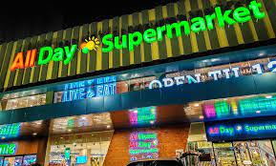
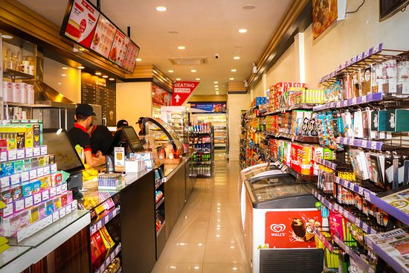
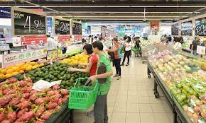
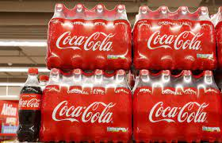
Connected Planning success in organizations worldwide
Gained visibility on Store Top performers and replicate the best seller items
Accurate, dynamic 18-month
rolling forecast
Ability to do 12-mo rolling forecast and reduced stockouts.
Pineapple company
$25 million in inventory carrying costs saved
Went from 2 weeks to 2 days for supply chain finance planning
Connected 68 bottlers across
the supply chain in 12 weeks

Slide 13
ECCO Shoes Production & Sourcing
Project initiated by Finance & Supply Chain
Model Designed by Global Supply Planning & Business Controlling
Manual allocation translated into Anaplan programming
Anaplan Demand, Supply, Inventory Planning
2 million euros costs avoidance driven by Duty & Freight optimization in the production allocation
Optimal allocation process done in less than one hour versus days allowing Planners to focus on quality
Technical constraints and available capacities efficiently planned throughout the season
New insights on the production footprint strategy
New capabilities in the Global Supply team: scenarios on capacities, technical constraints, demand changes and more
SAP ECC, SAP APO

Slide 14
Leveraging Data in Supply Chain
Organisations produce and process endless loads of data every single day. From sales numbers to supply chain efficiency, routine tasks and workflows leave a trail of detailed data insights that have the potential to transform businesses for the better.
But how can you ensure that organisations are making the most out of its data? Especially when it comes to complex supply chain operations that have dependencies across multiple teams and stakeholders?
Let us explore three ways organisation can leverage supply chain data to inform future growth and optimise processes across various points in the supply chain.
Improve Supply Chain Visibility
Inform Business Decisions
Measure Performance Over Time
Supply
Chain
Plan
Buy
Make
Move
Sell
Review

Slide 15
Leveraging Data in Supply Chain
1. Improve Supply Chain Visibility
Rather than limiting analysis to internal data or implementing time-consuming workarounds to access external data manually, invest in a scalable, integrated solution that will improve visibility across the entire supply chain. Leveraging a data management system and business intelligence platform enables organisations to collect and share data from multiple sources in real-time.
Leverage multi-source, automated reports to close knowledge gaps and give relevant stakeholders a clear view of the supply chain’s end-to-end performance.
This approach also allows supply chain partners to align behind a single source of truth and dissolve siloes between touchpoints.

Slide 16
Leveraging Data in Supply Chain
2. Inform Business Decisions
The reports organisations create with your supply chain data should go beyond day-to-day operations and error resolutions. Organisations should also explore how each reporting tool or feature contributes to long-term forecasting and trend analysis.
Historical supply chain data offers a wealth of information about overall performance and offers clues into future opportunities for growth or improvement.
Invest and deploy analytical solutions that make it easy to identify patterns and trends across the extended supply chain, then present them all through easy-to-use dashboards or similar readouts.
As organisations gain more insight into performance, efficiency, and recurring trends across your supply chain, they’ll be able to better forecast future needs and adjust their supply chain strategy accordingly.
Whether redefining processes to improve efficiency or identifying trends using predictive insights, organisations can leverage data across the extended supply chain, not just a hunch or vague recommendations, to inform business decisions and drive growth.

Slide 17
Leveraging Data in Supply Chain
3. Measure Performance Over Time
Each department, or partner, that interacts with an organisation’s supply chain uses pre-defined key performance indicators (KPIs) to monitor their performance and progress towards long-term business goals. A department’s KPIs will probably be a combination of hard metrics and more holistic goals, such as:
Forecast Performance
Order Performance
Supply Performance
Customer Service Levels
Supply chain leaders may feel confident in their ability to monitor specific KPIs through routine evaluations and performance reviews. However, without accurate, real-time supply chain data, tracking data-driven KPIs is nearly impossible.
To effectively tie supply chain data back to business performance, connect with each department lead and your high-level stakeholders to identify or confirm high-priority KPIs, as well as the specific success metrics associated with each. This allows you to determine the value proposition for the organisation and how organisations track and measure success.

Slide 18
Leveraging Data in Supply Chain
The first step towards developing a data-driven supply chain is understanding the holistic value of your supply chain data.
The right tools can help organisations collect, organise, and analyse data from multiple sources and sectors within the extended supply chain.
These tools will support organisations establish a scalable data strategy that will deliver value in the long term.

Slide 19
OnDemand Demos
Anaplan Demo Trailer: Demand Management
Anaplan Demo Trailer: Sales & Operations Planning
Anaplan Demo Trailer: Supplier Collaboration
Anaplan Demo Trailer: Supply Planning

Slide 20
Thank you
For More Information
To find out more about Cornerstone and CPM Group, please contact:
Cornerstone Level 13, 55 Clarence Street Sydney NSW 2000 Telephone: 1300 841 048 E-mail: info@cornerstone.com.au
Notes:
Note: Send to back the “Gradient” shape, add your image into “Image Placeholder”, right click on it and “Send to Back” to get the gradient effect.

